Slide 1



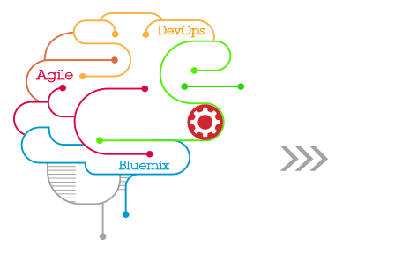

Bluemix Introduction and Practices

Slide 2
Agenda
1. IBM Cloud Services
2. Introducing IBM Bluemix
2.1 Bluemix Architecture
2.2 Innovation is fueled by Open standards for Bluemix
2.3 What can Bluemix Deliver?
2.4 Scaling and Monitoring in Bluemix
2.5 Which services can Bluemix offer?
3. Bluemix Management
3.1 Bluemix management - Dashboard
3.2 Bluemix management – APP Dashboard
3.3 Bluemix management – APP Runtime
3.4 Bluemix management – APP Files and Logs
3.5 Bluemix management – APP Environment Variables
3.6 An example to add Node.js app and bind a service
4. Integration – API Management, Cloud Integration, Secure Gateway and IMC
5. Bluemix DevOps Services
5.1 DevOps – Track/Plan
5.2 DevOps – Code
5.3 DevOps – Build/Deploy
5.4 DevOps - Bluemix Live Sync Process
6. Practice tips
7. Bluemix environments

Slide 3
1.1 IBM Next Generation Cloud Environment
API
Economy
External
Ecosystem
analytics
commerce
collaboration
location
data
services
Software
as a Service
API
API
API
API
API
API
Marketplace
App
Solutions
Cloud Operating Environment
API
API
Platform
as a Service
Services & Composition Patterns
Traditional
Workloads
API & Integration Services
development
operational
mobile
…
data
security
application services
Software
Defined
Environment
Workload definition, Optimization, & Orchestration
Infrastructure as a Service
Resource Abstraction & Optimization
Software Defined Compute
Software Defined Storage
Software Defined Networking

Slide 4
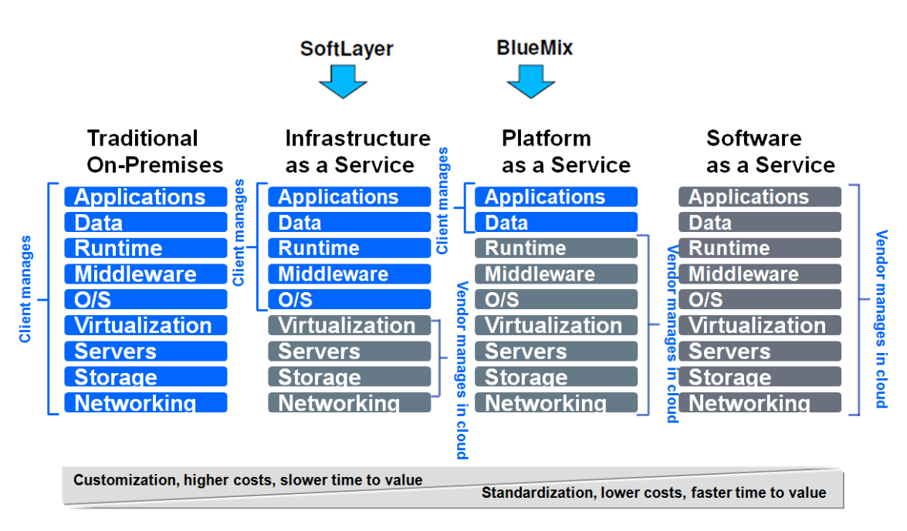
1.2 IBM-provided cloud services models

Slide 5
1.3 Why not just use IaaS?
It might be just as easy to get started at the IaaS layer if you use a prebuild image
Over time though the maintenance of this image increases the cost
OS updates, security updates, new versions of libraries, DNS and networking changes, configuration and maintenance of other services like DBs etc.
At the PaaS layer all of this cost disappears! The platform takes care of it for you!
1.3.1 Benefits of using Bluemix:
Save time by just worrying about the code and not the infrastructure
Quickly get your app in the hands of your users – deploying your app is a matter of running a single command
Easily add functionality to your application using IBM and partner provided services
Use the languages, runtimes, and frameworks that you are most familiar with

Slide 6
2 Introducing IBM Bluemix
Bluemix is IBM’s new PaaS solution that combines the power of Cloud Foundry with popular languages and IBM SaaS.
IBM BlueMix
Lifecycle Management
(JazzHub)
IBM initiative to develop an open Cloud Operating Environment
Runs on SoftLayer
Integrated DevOps with both Browser and Eclipse-based tools
Check In Code
Check In Code
Create & Manage Services
Web IDE
(Eclipse Orion)
Application Composition
Environment
Eclipse IDE
Explore
Services
Explore
Services
Test/Run
Application Runtime
Test/Run
Runtimes & Frameworks
node
java
WebSphere Liberty
ruby
Worklight
Services
Middleware
Application
Data
Operational
Mobile
External

Slide 7
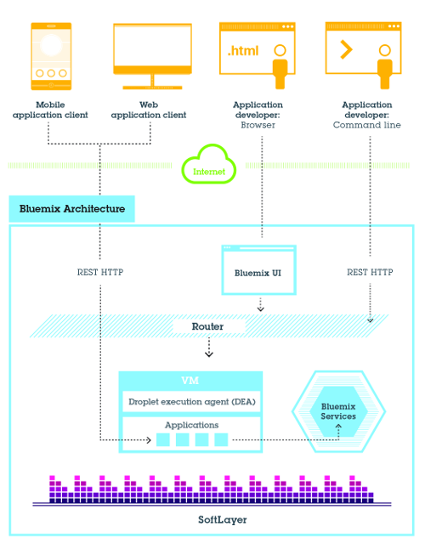

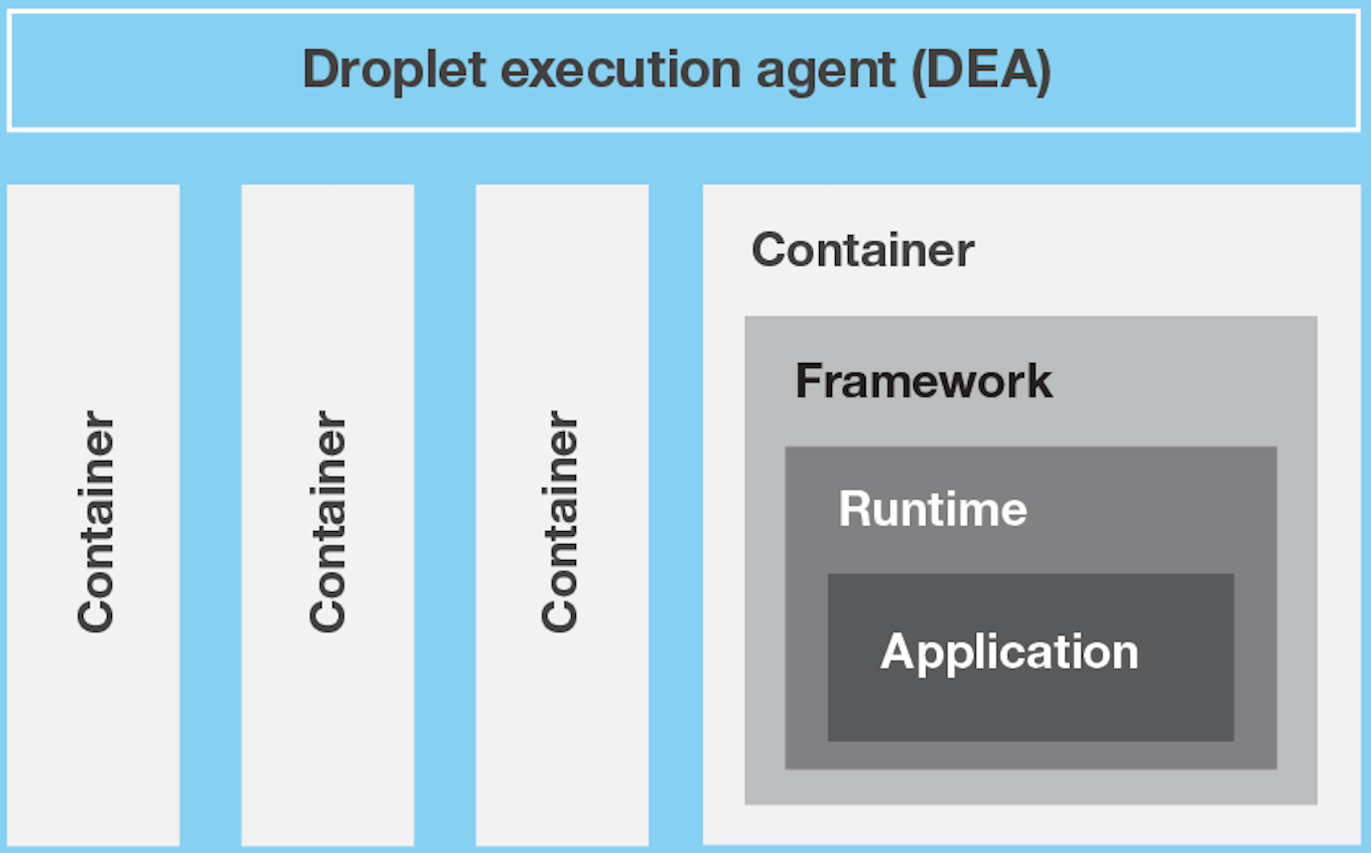
2.1 Bluemix Architecture

Slide 8












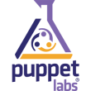















2.2 Innovation is fueled by Open standards for Bluemix
Tools & DevOps
Developers prefer freedom of choice
OSLC
Runtime
TOSCA
Services
Integration
CMIS
OAuth

Slide 9
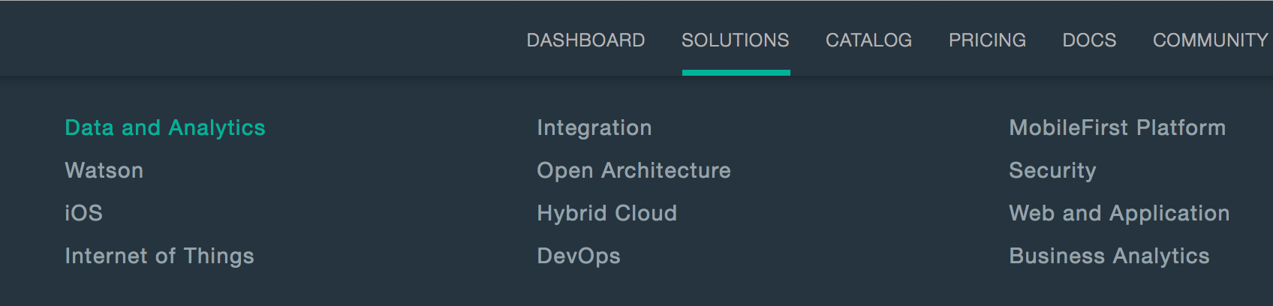
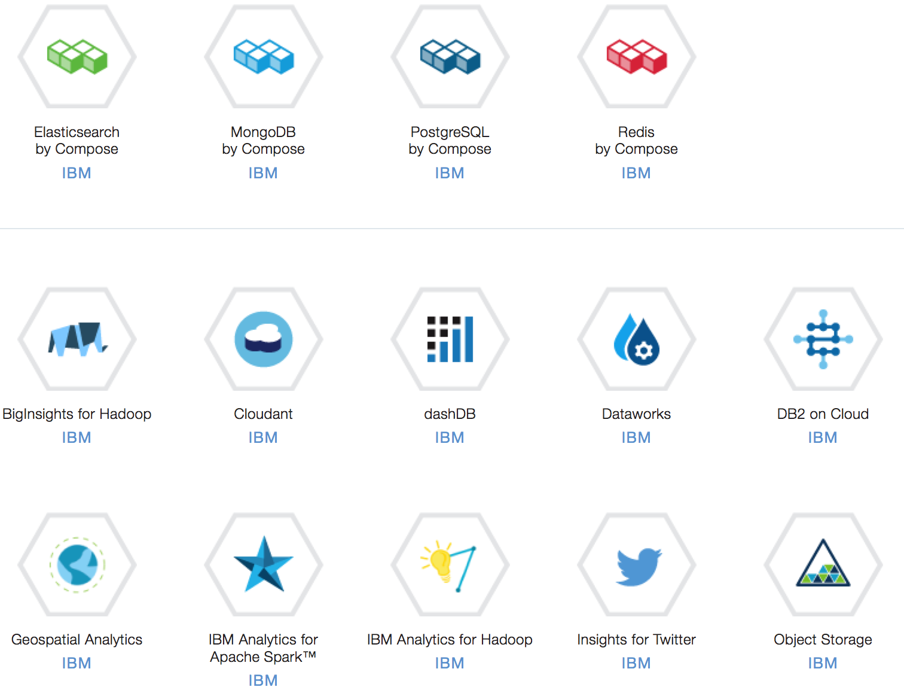
2.3 What can Bluemix Deliver?
---Delivering a Composable Services development environment
Run Your Apps
The developer can chose any language runtime or bring their own. Just upload your code and go.
DevOps
Development, monitoring, deployment and logging tools allow the developer to run the entire application
APIs and Services
A catalog of open source, IBM and third party APIs services allow a developer to stitch together an application in minutes.
Cloud Integration
Build hybrid environments. Connect to on-premises systems of record plus other public and private clouds. Expose your own APIs to your developers.
Extend SaaS Apps
Drop in SaaS App SDKs and extend to new use cases (e.g,. Mobile, Analytics, Web)

Slide 10
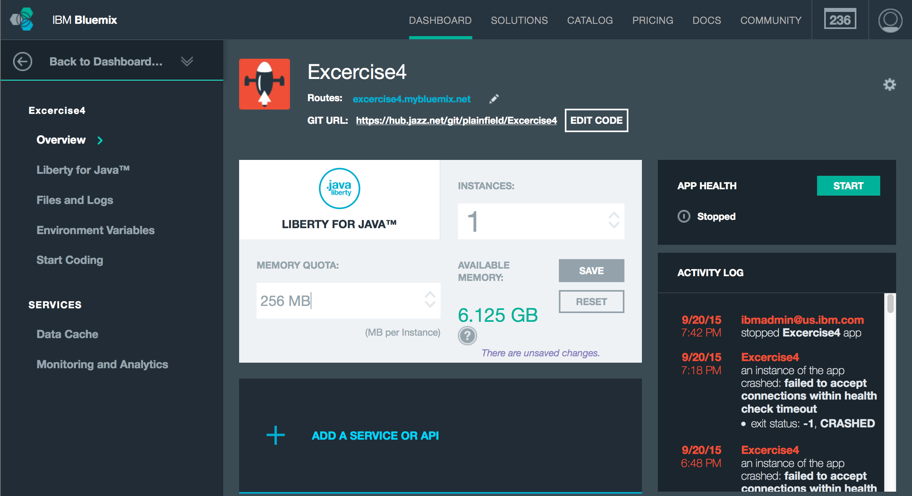
2.4 Scaling and Monitoring in Bluemix
---Fully integrated environment for deploying and managing your application
Single Dashboard
Single view of application health, usage and status
Health and Monitoring
Integrated monitoring and diagnostics with the ability to add on features such as code level tracing
Scaling
Ability to scale the application by adding new runtime instances

Slide 11
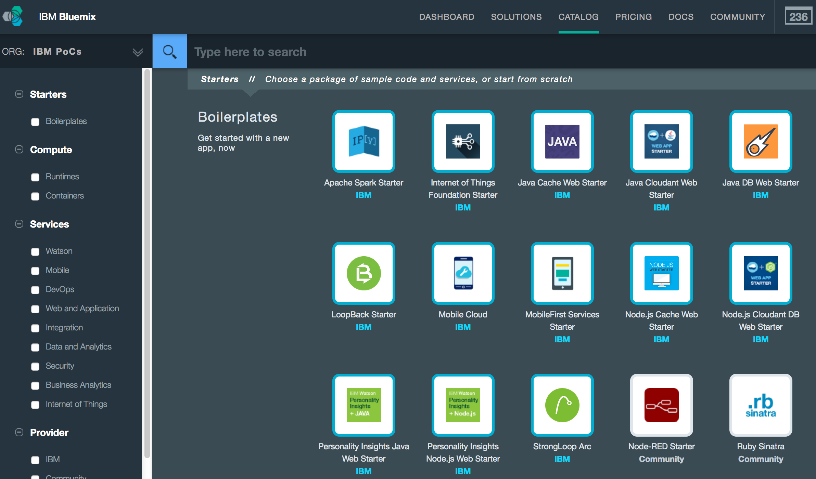
2.5 Which services can Bluemix offer?
The service marketplace is defined as the aggregate catalog of services and plans advertised to a Cloud Foundry instance by all registered brokers.
The IBM BlueMix Services are the main differentiator against other Cloud Foundry PaaS Offerings such as Pivotal.
Integrate and Share is the mission.

Slide 12
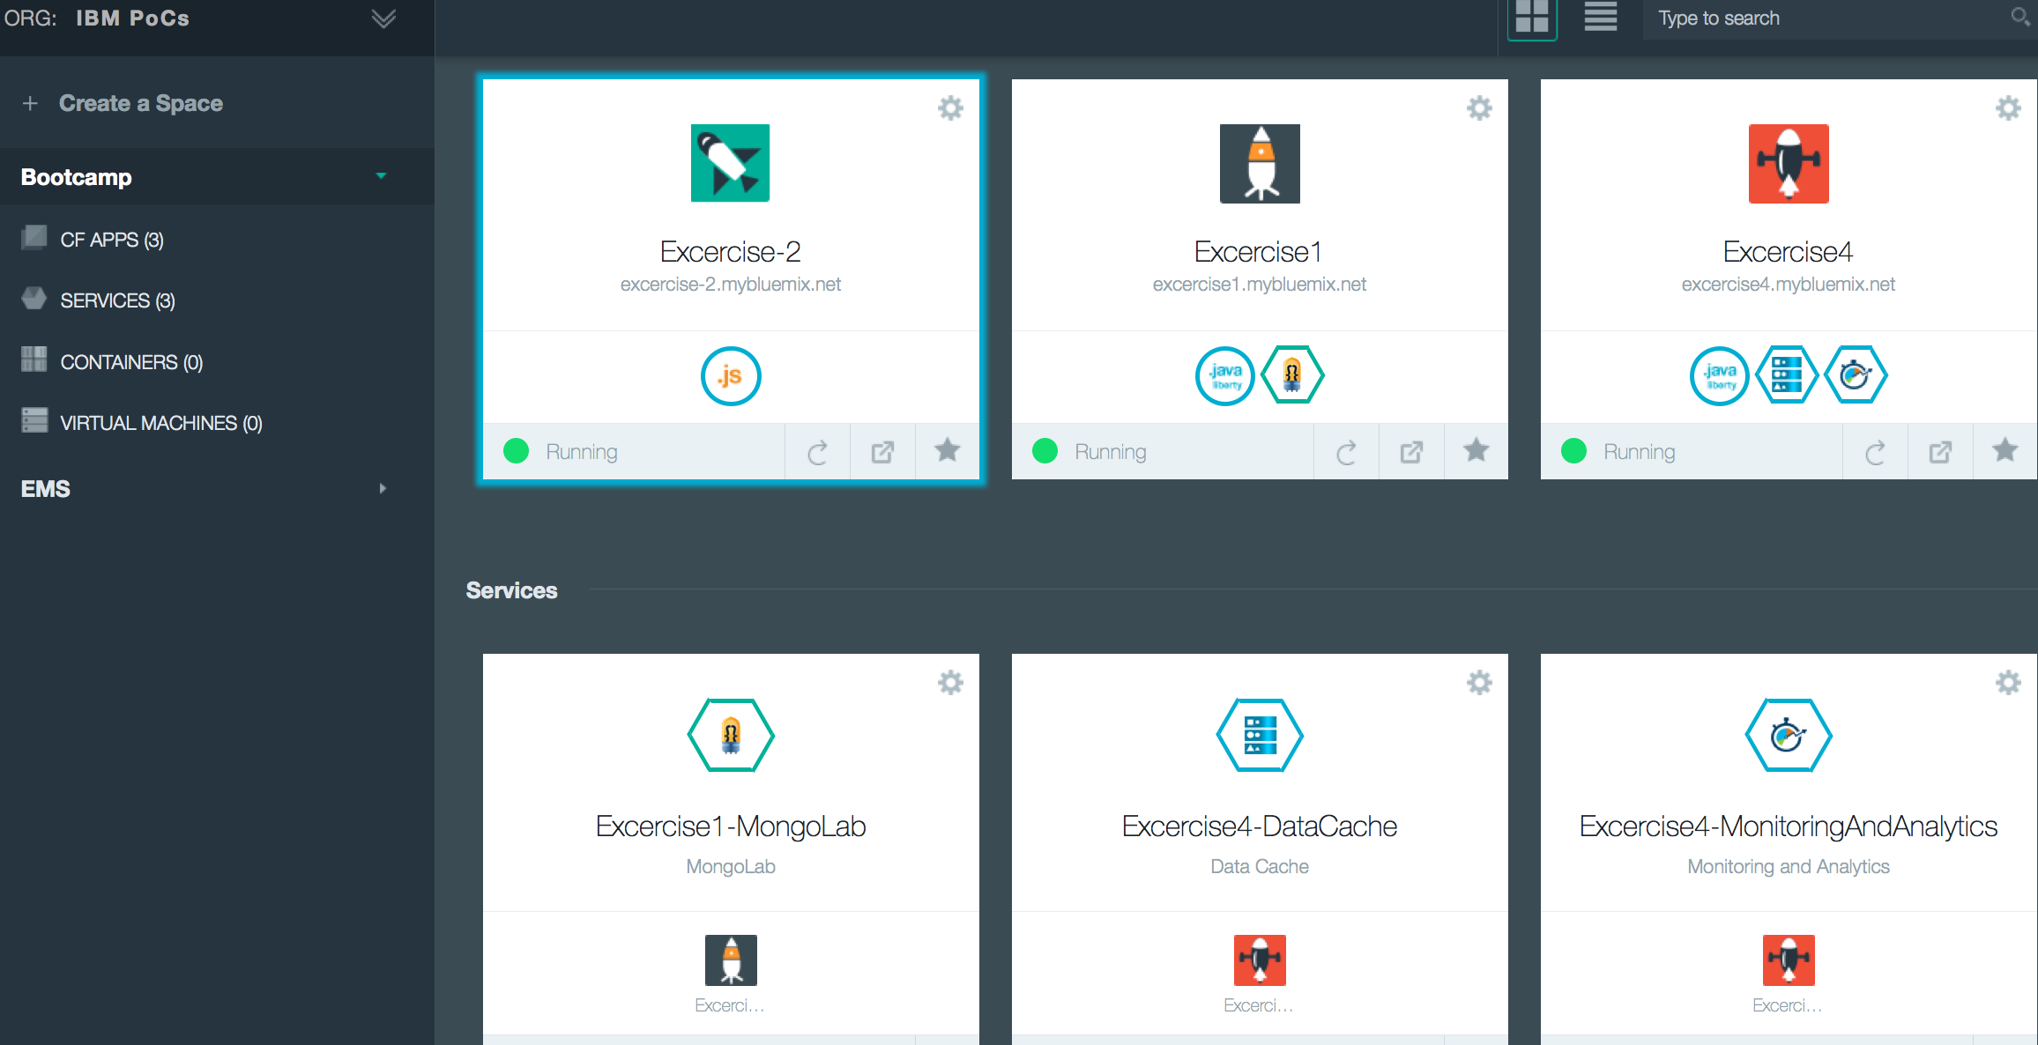
3.1 Bluemix management - Dashboard
These services can be shared with the other APPs

Slide 13
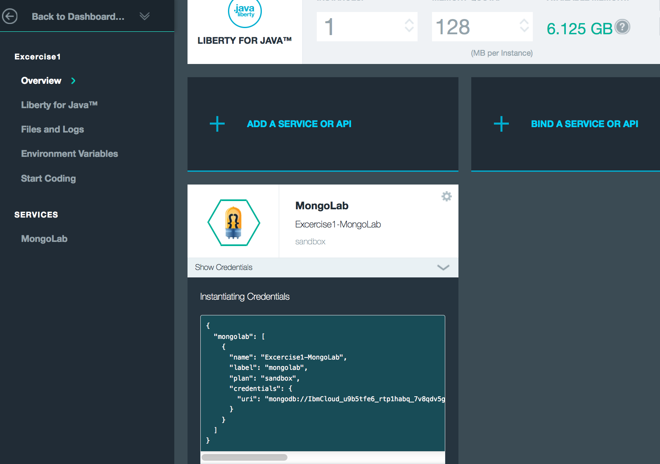
3.2 Bluemix management - APP Dashboard ---Show service credentials

Slide 14
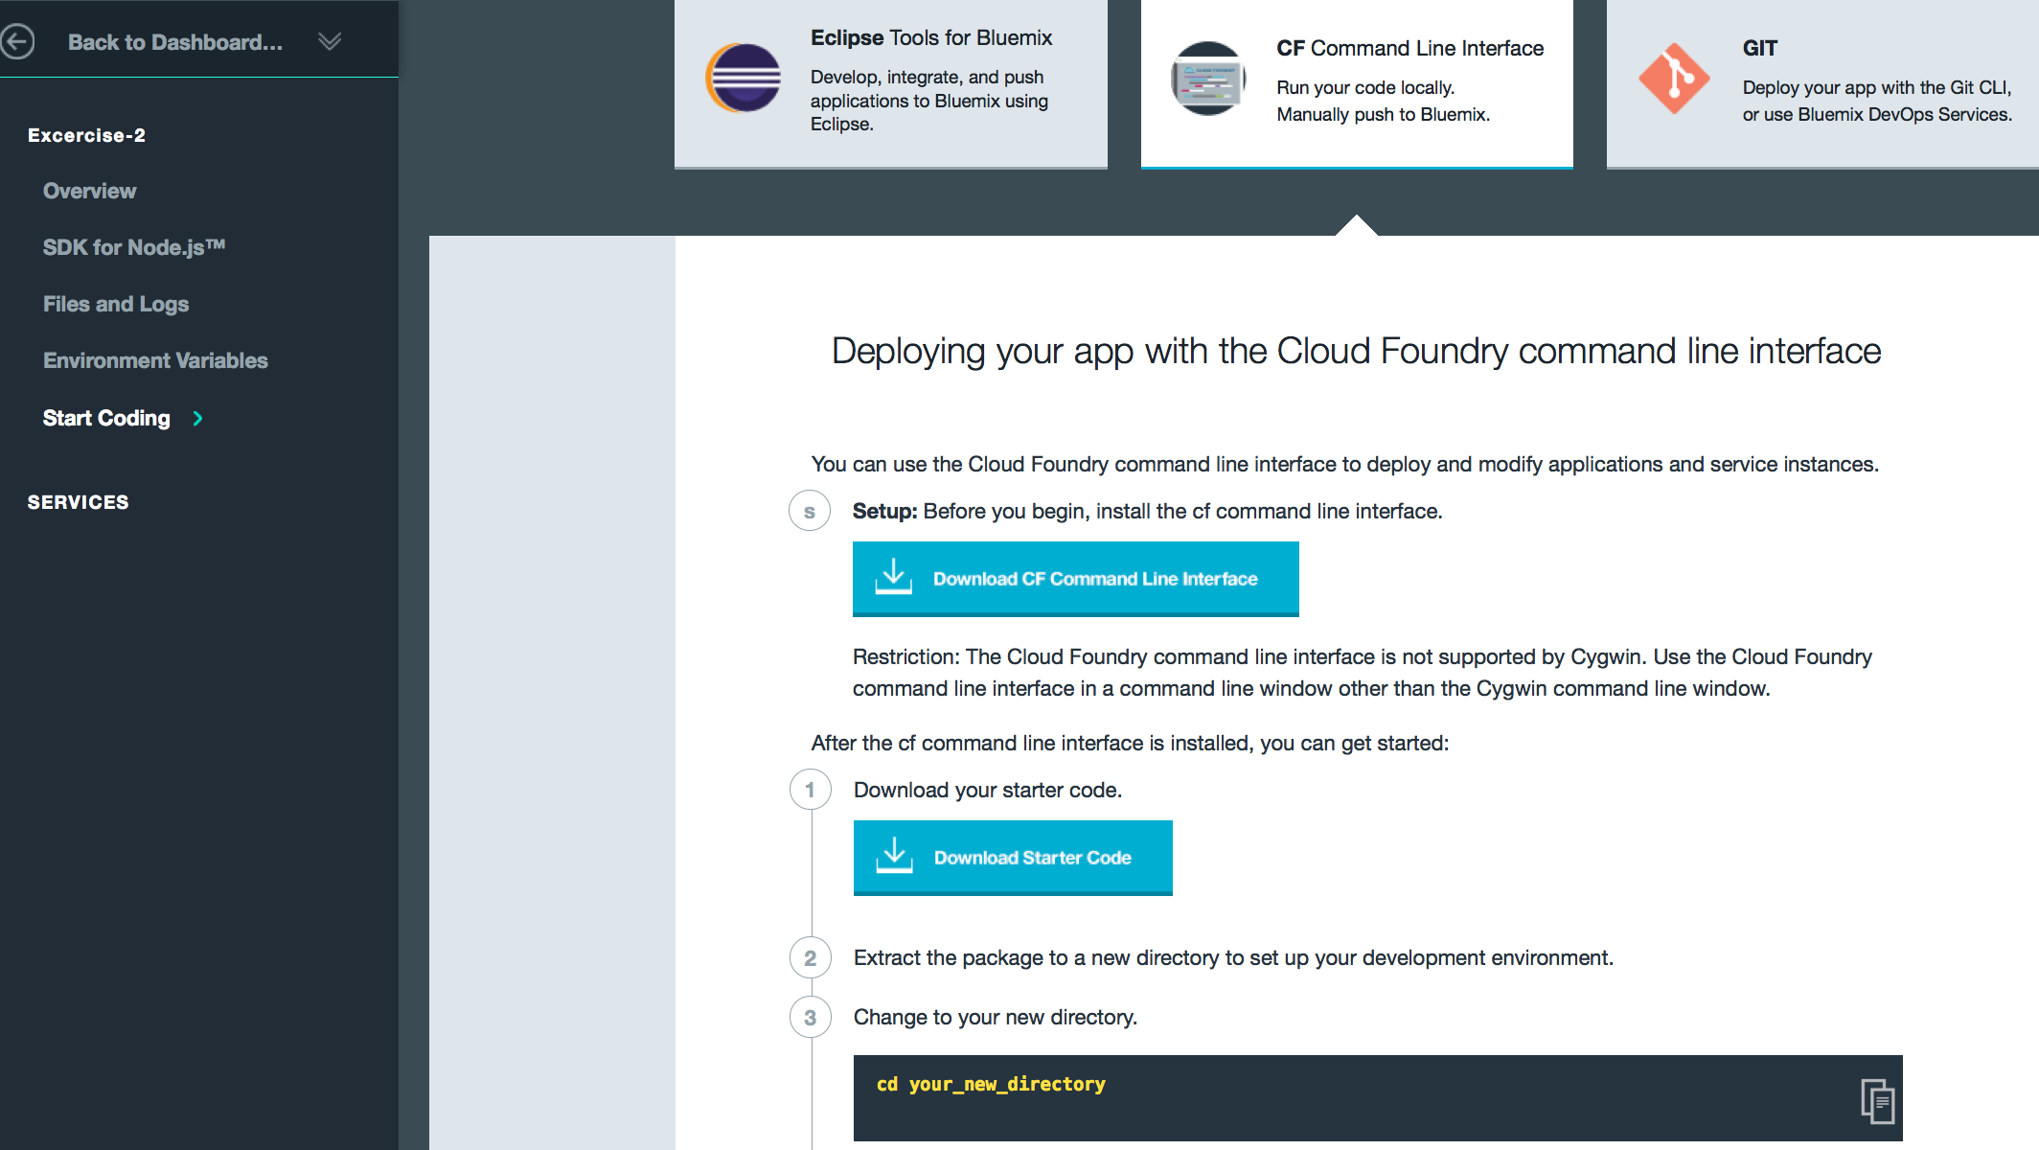
3.2 Bluemix management - APP Dashboard#Guide ---View coding guide for this app

Slide 15
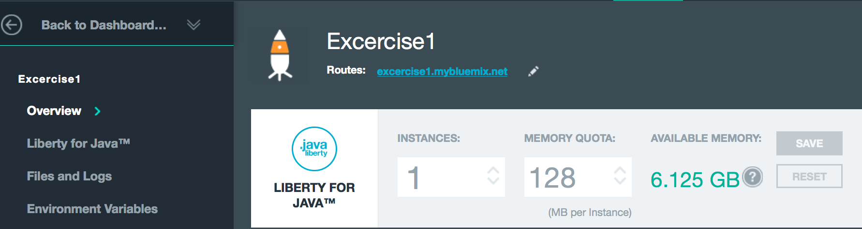
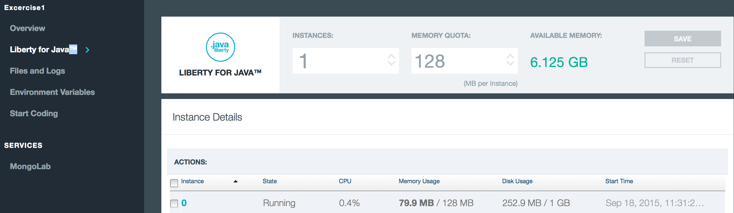
3.3 Bluemix management – APP Runtime

Slide 16
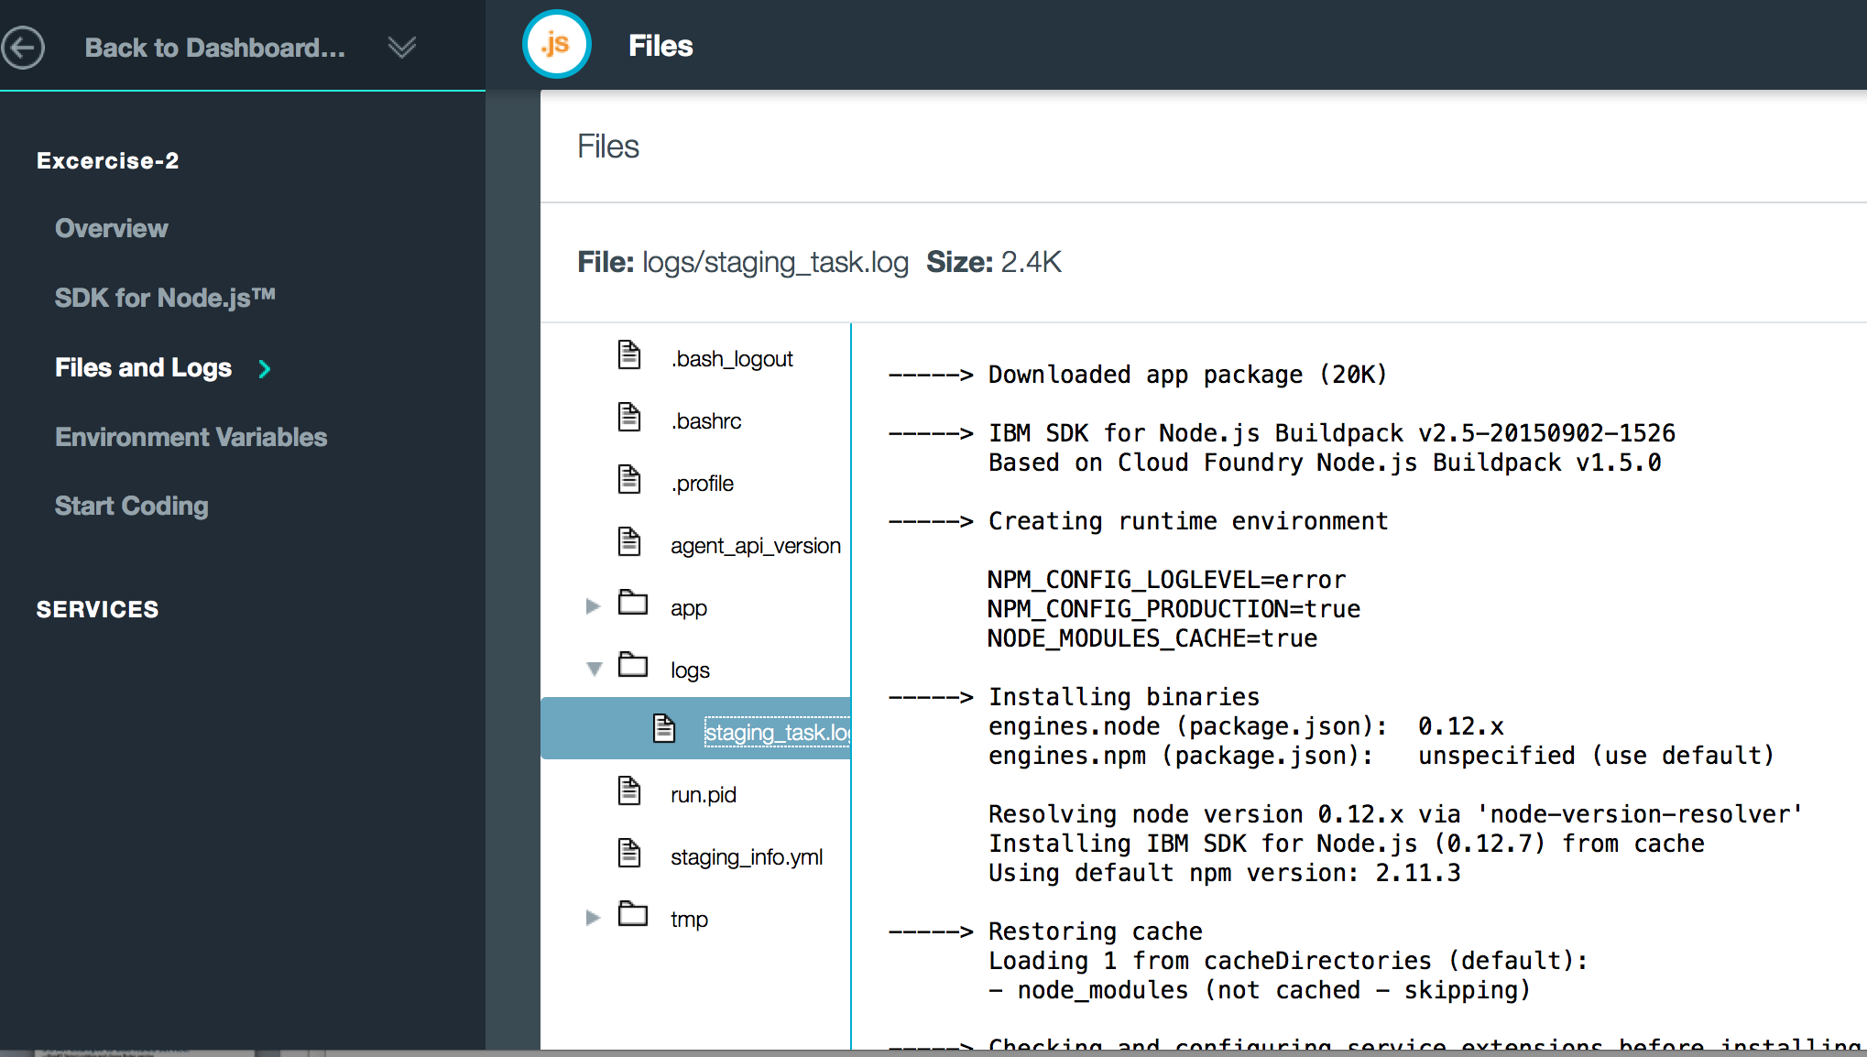
3.4 Bluemix management – APP Files and Logs

Slide 17
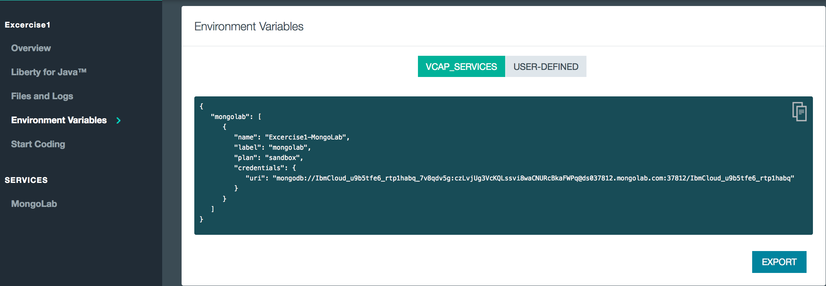
3.5 Bluemix management – APP Environment Variables

Slide 18
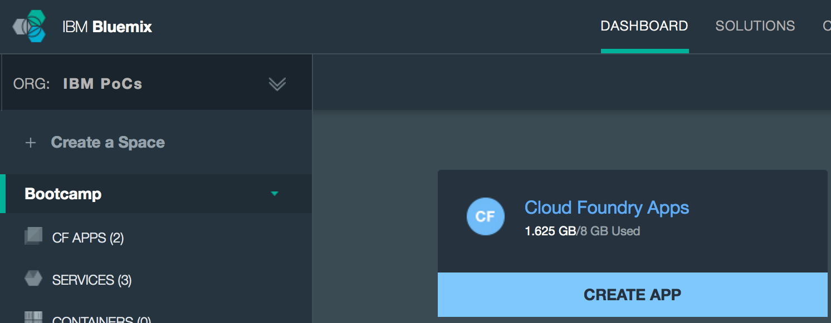
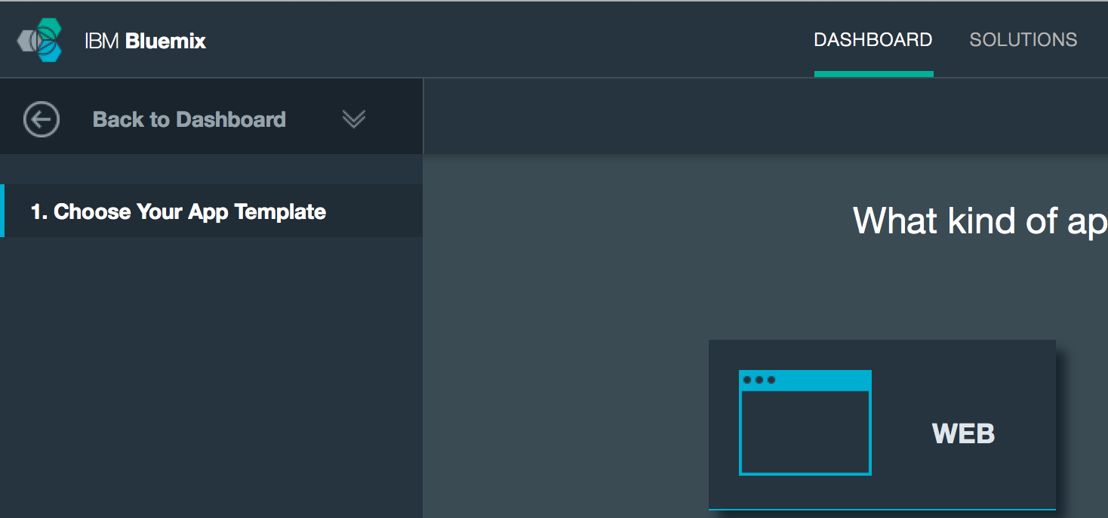
3.6 An example to add Node.js app and bind a service#1

Slide 19
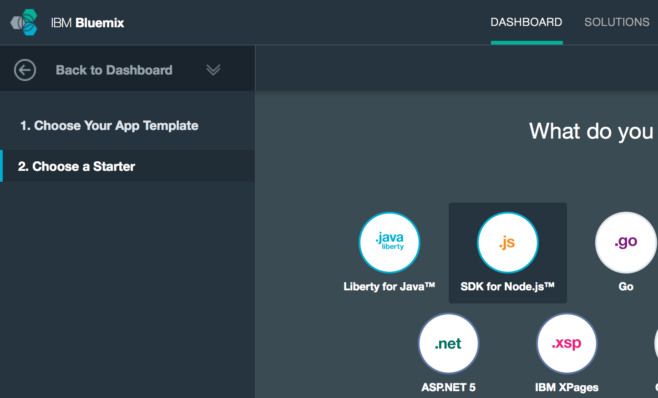
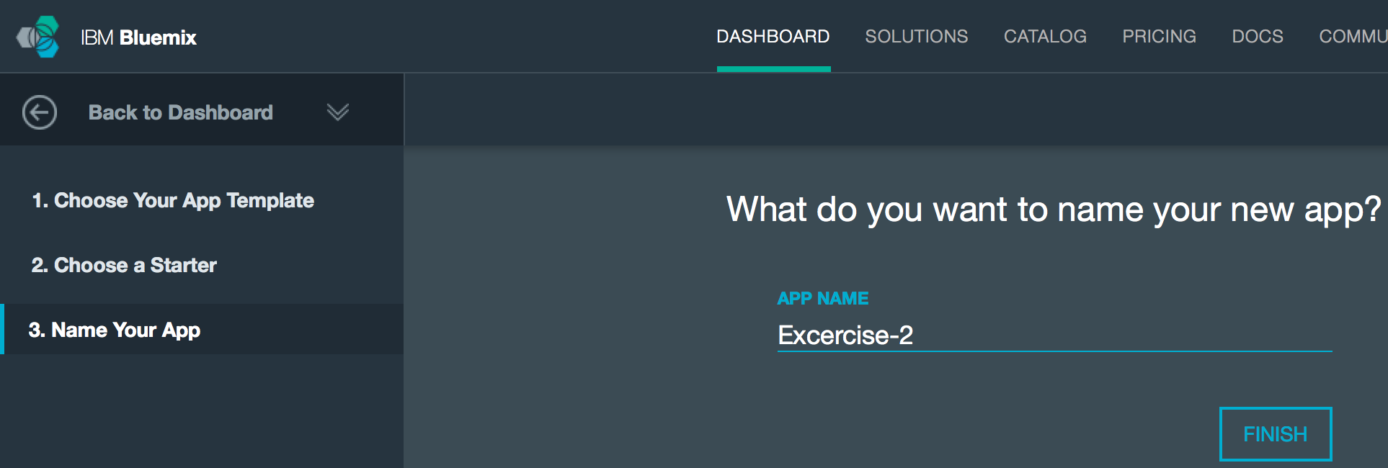
3.6 An example to add Node.js app and bind a service#2

Slide 20
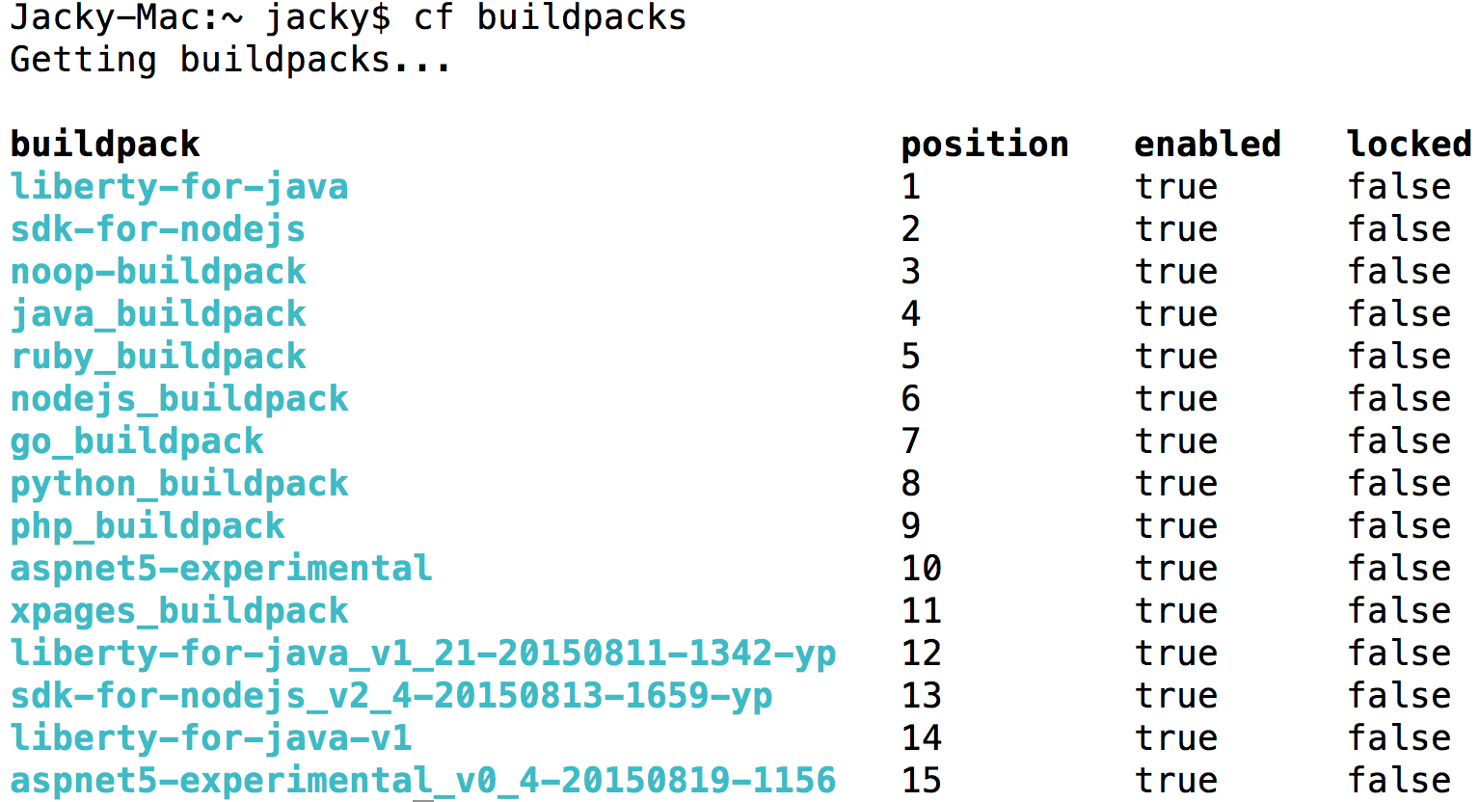
3.6 An example to add Node.js app and bind a service#3 ---It will use the default Node.JS buildpack as follows, you can get it by “cf buildpacks”

Slide 21
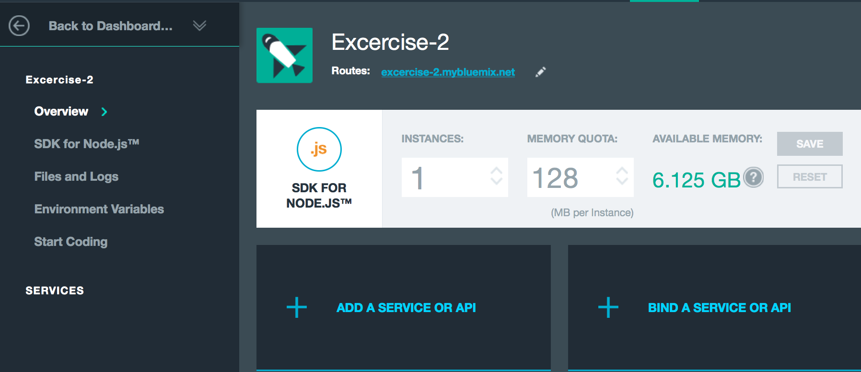
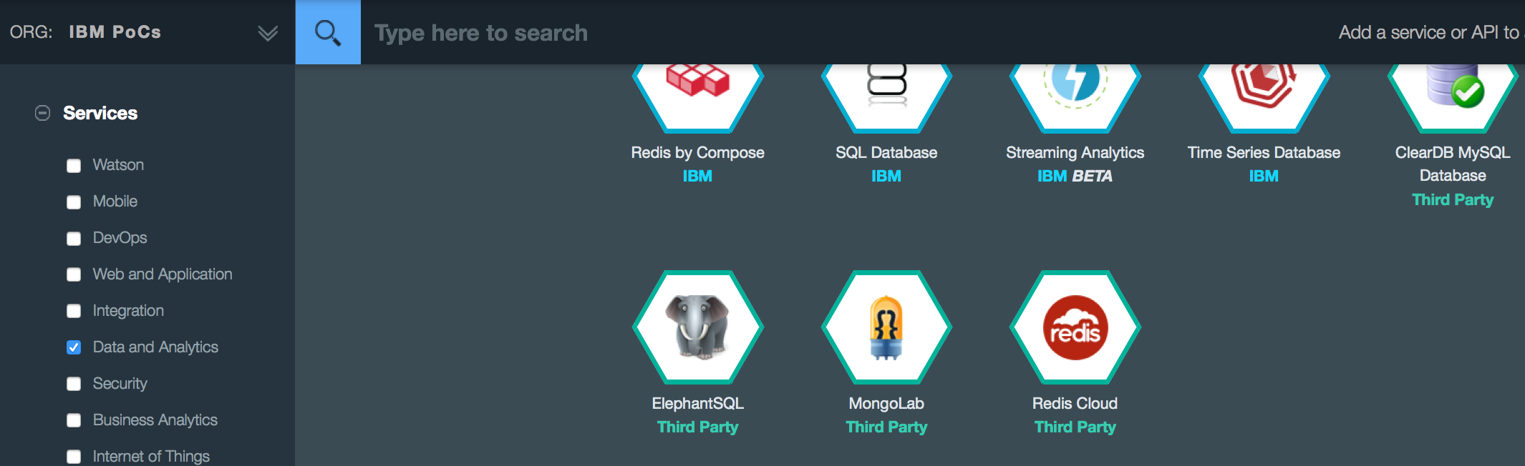
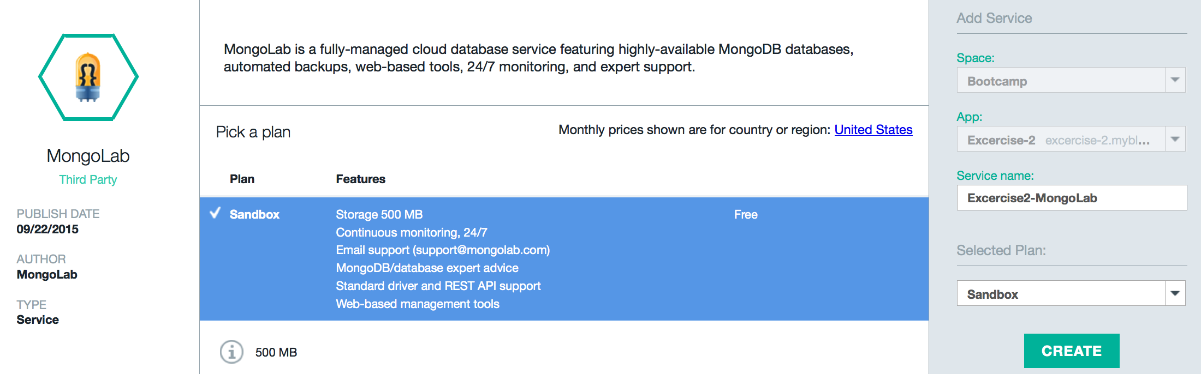
3.6 An example to add Node.js app and bind a service ---Add a MongoLab service

Slide 22
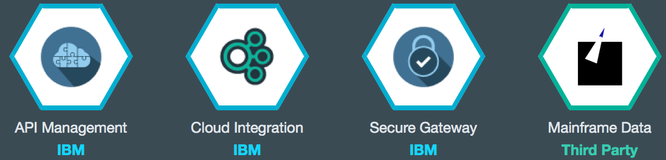
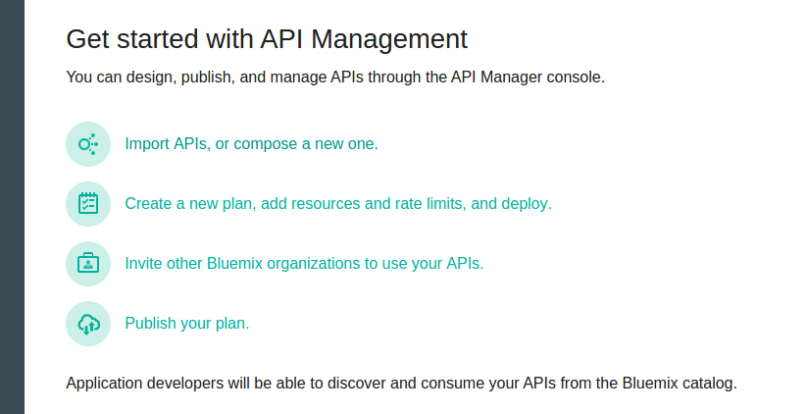
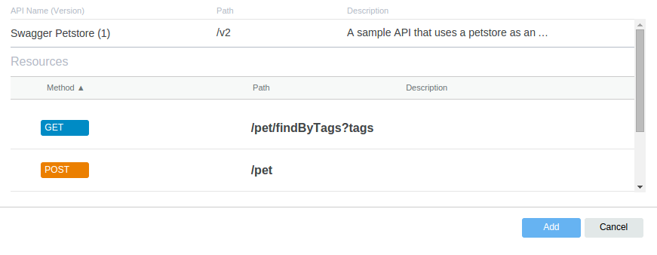
4.1 Integration - API Management ---Extend existing investments and infrastructure

Slide 23
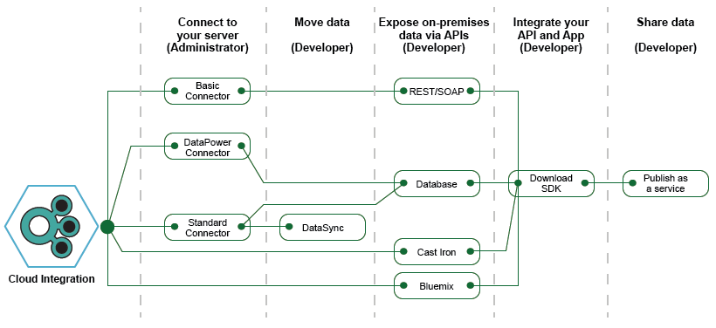
4.2 Integration – Cloud Integration ---Extend existing investments and infrastructure

Slide 24
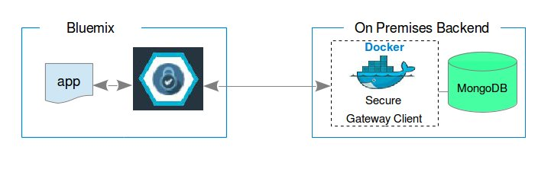
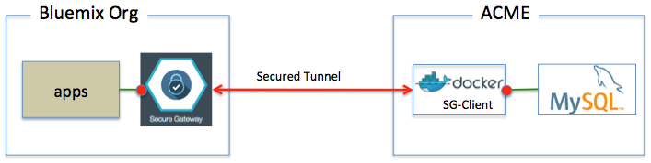
4.3 Integration – Secure Gateway ---Extend existing investments and infrastructure
REF:https://developer.ibm.com/bluemix/2015/03/27/bluemix-secure-gateway-yes-can-get/
SDK
Hypothetical company
No TLS(Console)/TLS

Slide 25





4.4 Integration – With IMC
SQLDB
3rd App:EMS
IMC
Server
IBMerServices
LDAPS
BluePages
Server
Wireless route
HTTPS
HTTPS
HTTPS
HTTPS
Liberty Server
Node.JS Server
Faces
Server
Public Bluemix
Dedicated Bluemix
Internet
Yellow zone
Blue zone

Slide 26

5. What is IBM Bluemix DevOps Services
IBM® Bluemix™ DevOps Services is software as a service (SaaS) on the cloud that supports continuous delivery.
IBM Bluemix DevOps Services provides these capabilities:
Agile planning, through the Track & Plan service
A Web IDE for editing and managing source control
Source control management (SCM), through Git, Jazz SCM, or GitHub
Automated builds and deployments, through the Delivery Pipeline service

Slide 27
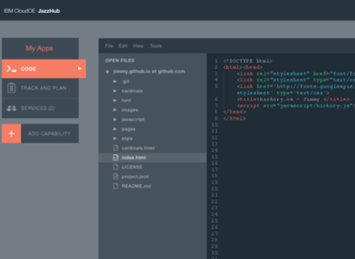
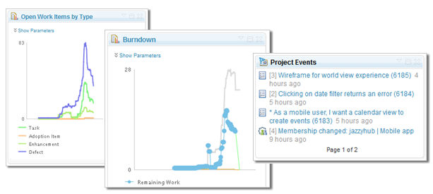
5 DevOps Overview
Continuous Integration, Agile Project Planning and Integrated IDEs
An Integrated Developer Experience
DevOps Solution in the cloud for developing applications.
Integrated task tracking, agile planning, source control with auto deploy
Complementary mobile quality and application performance monitoring
Use your favorite tools or work from the Web IDE
Continuous Integration: Automate builds, unit and integration testing and deployment to the Cloud using Jenkins and Rational Team Concert

Slide 28
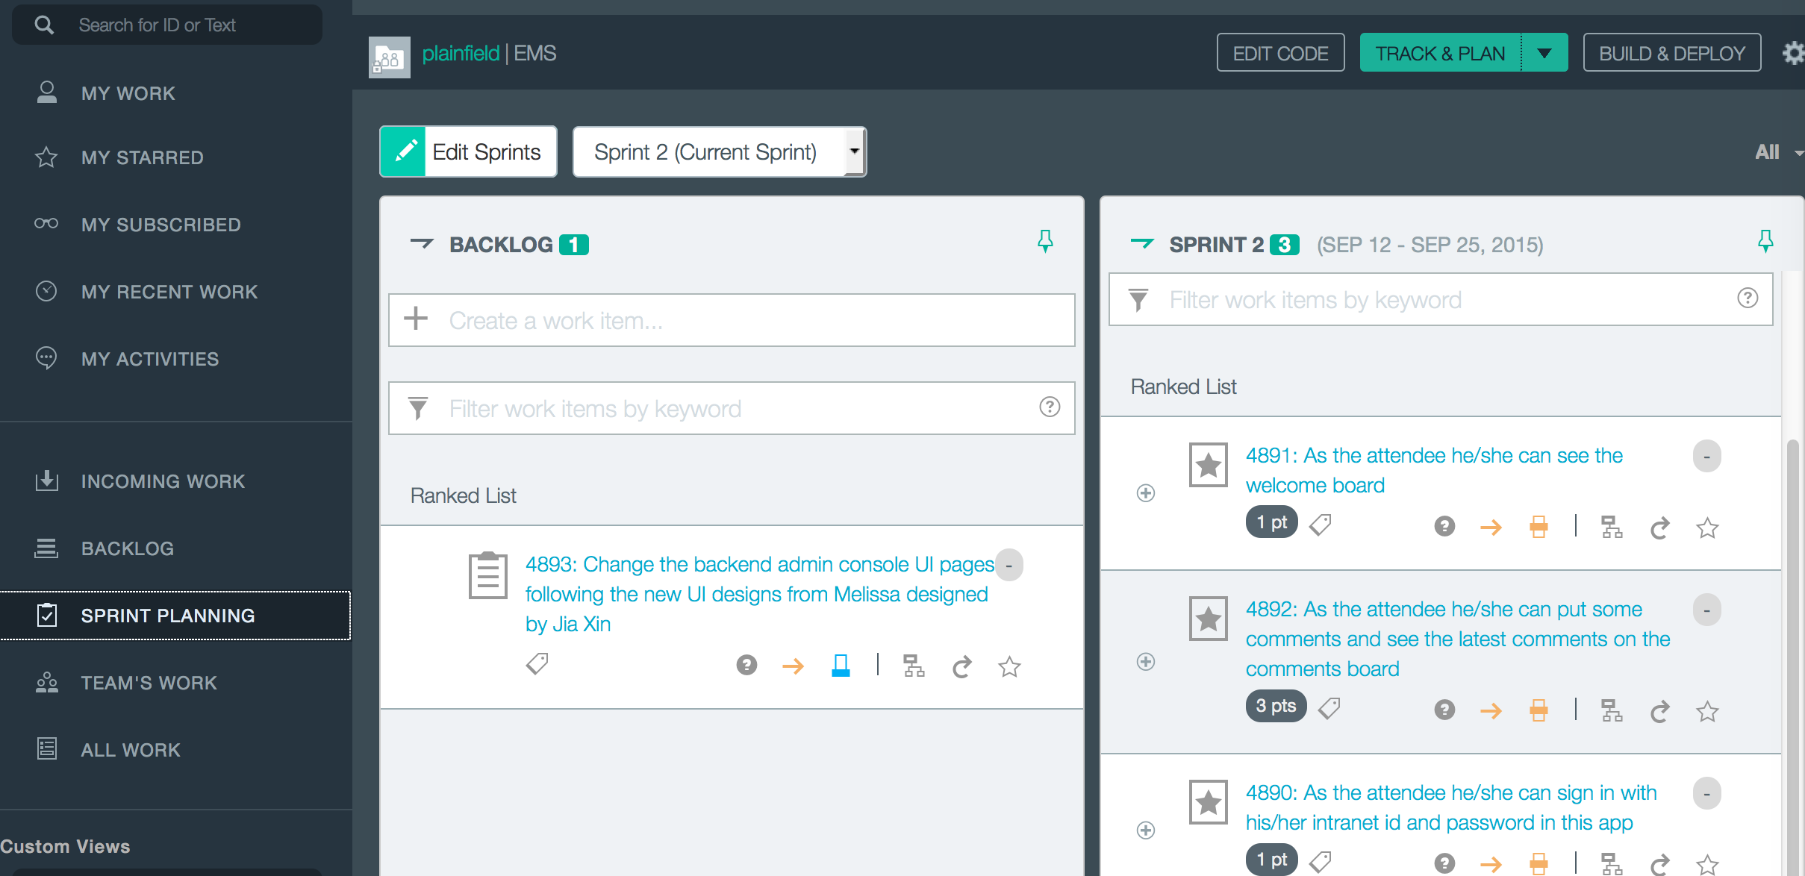
5.1 DevOps – Track/Plan#1(Sprints and Backlogs)

Slide 29
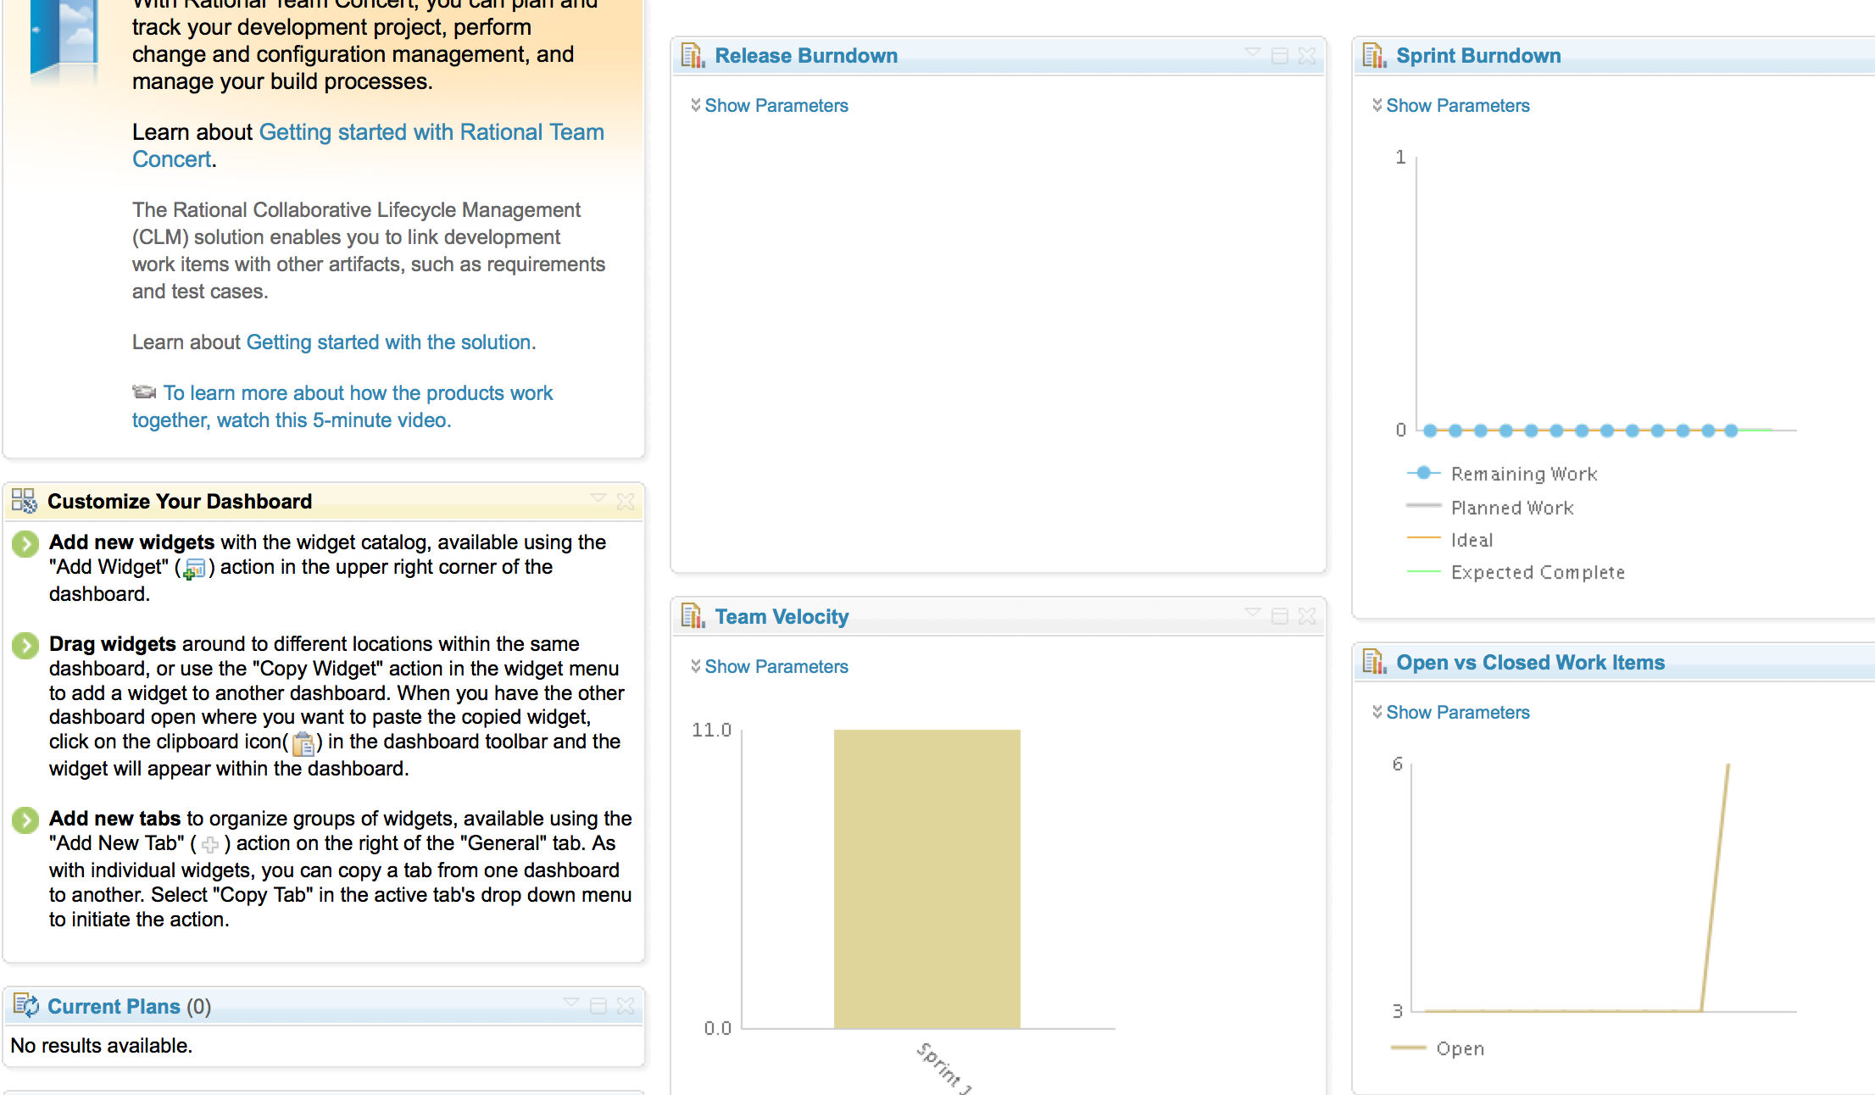
5.1 DevOps – Track/Plan#2(Project Dashboard)

Slide 30
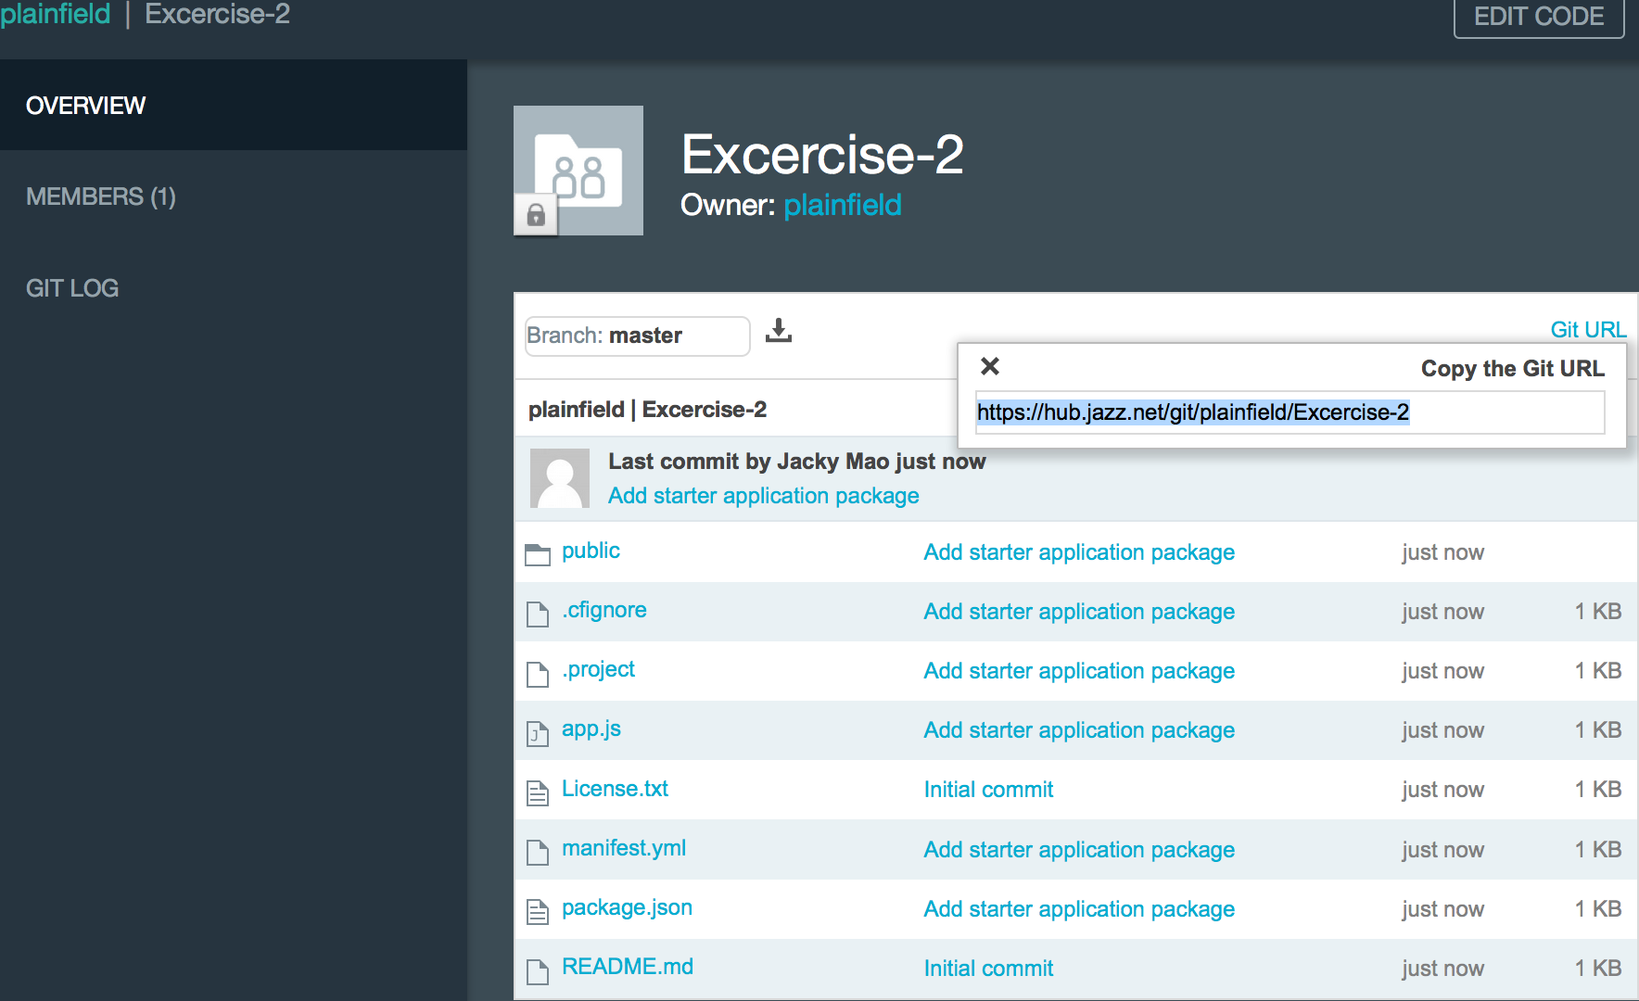
5.2 DevOps – Code#1(Git Repository)

Slide 31
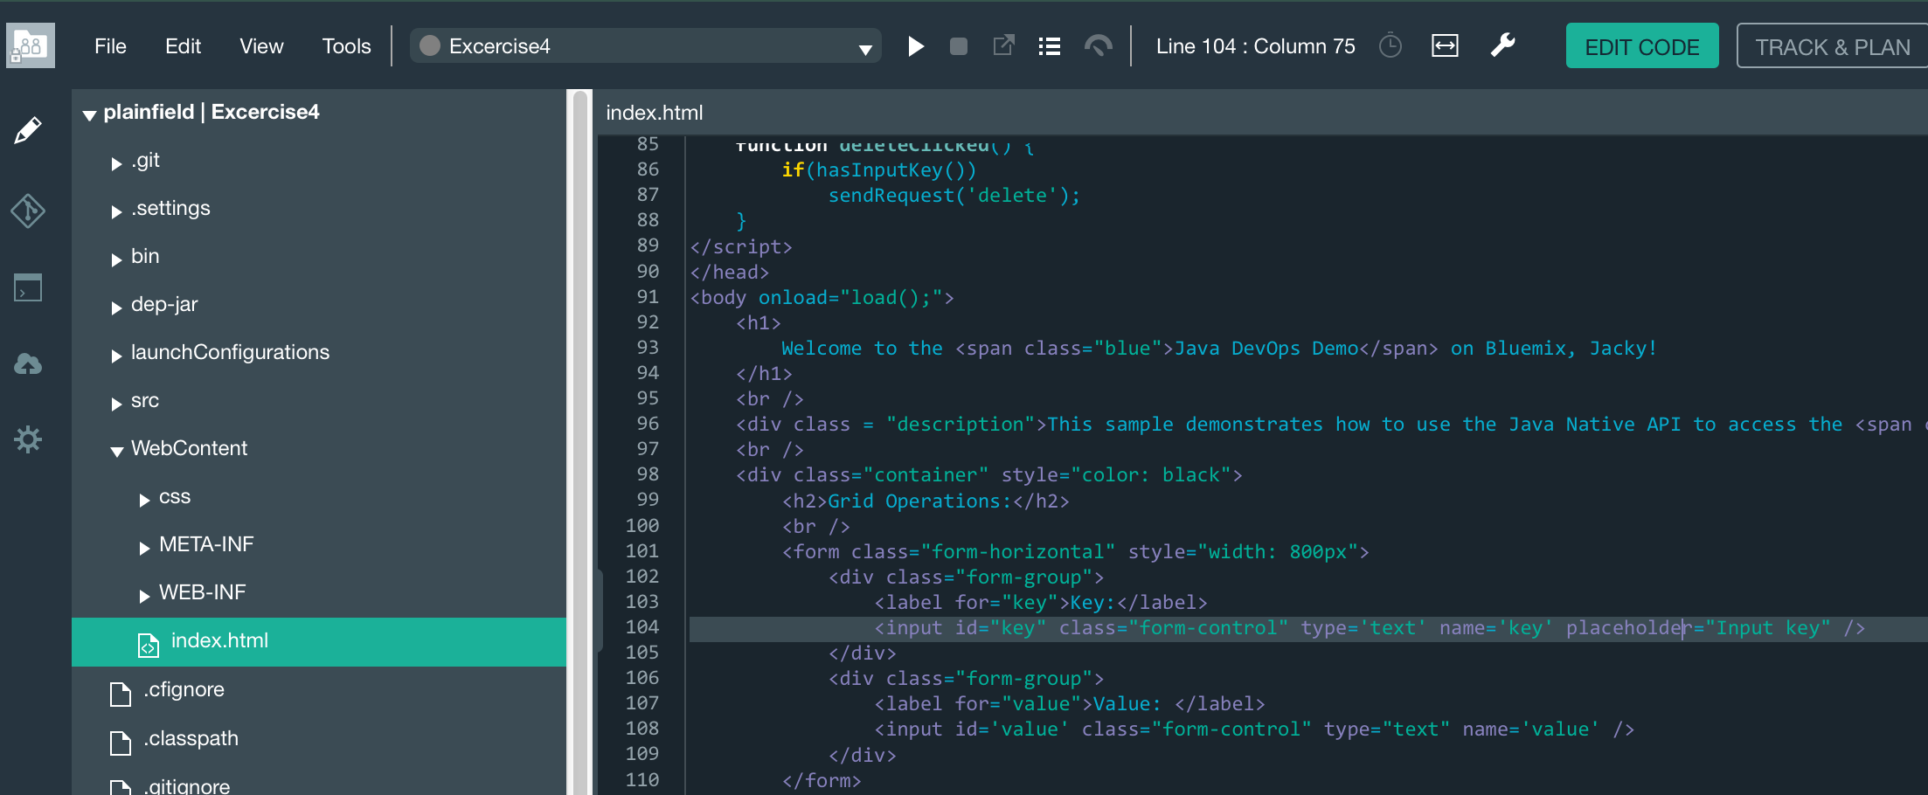
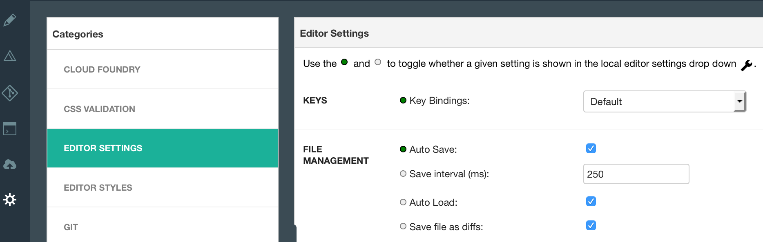
5.2 DevOps – Code#2(Edit)

Slide 32
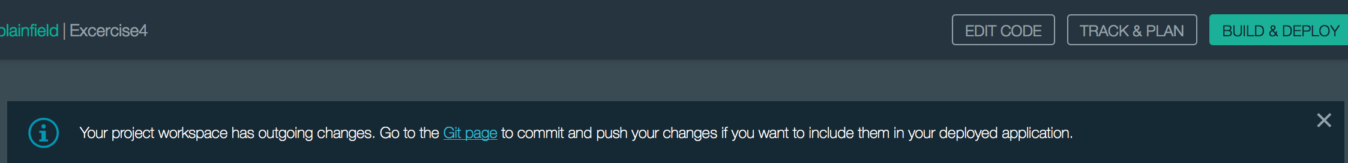
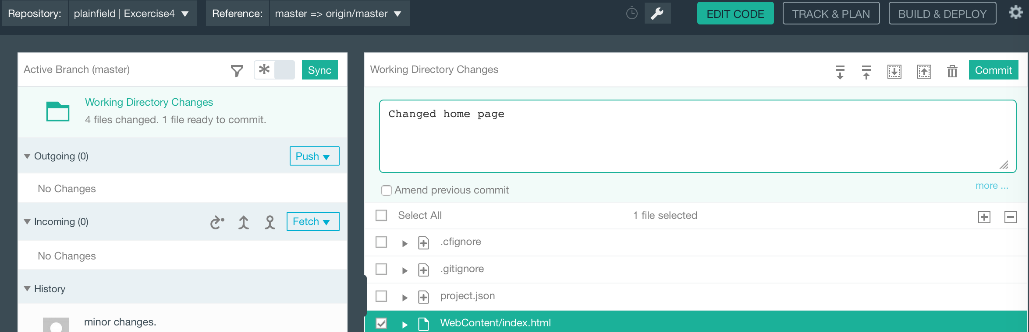
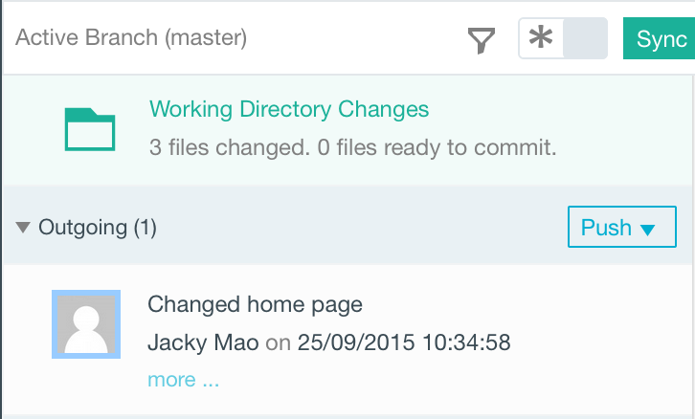
5.2 DevOps – Code#3(Submit/Push)

Slide 33

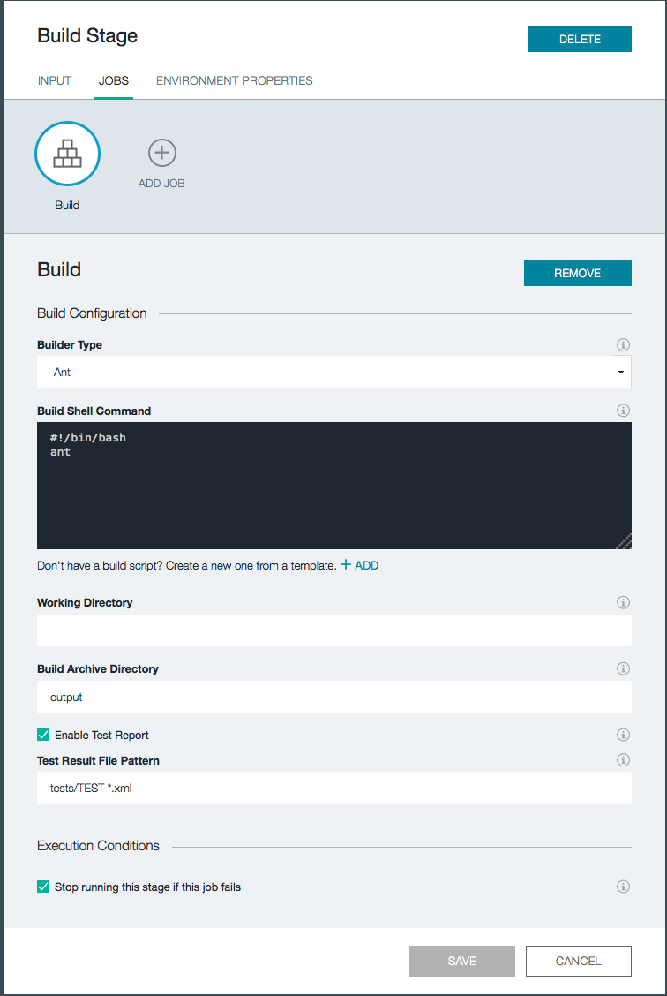
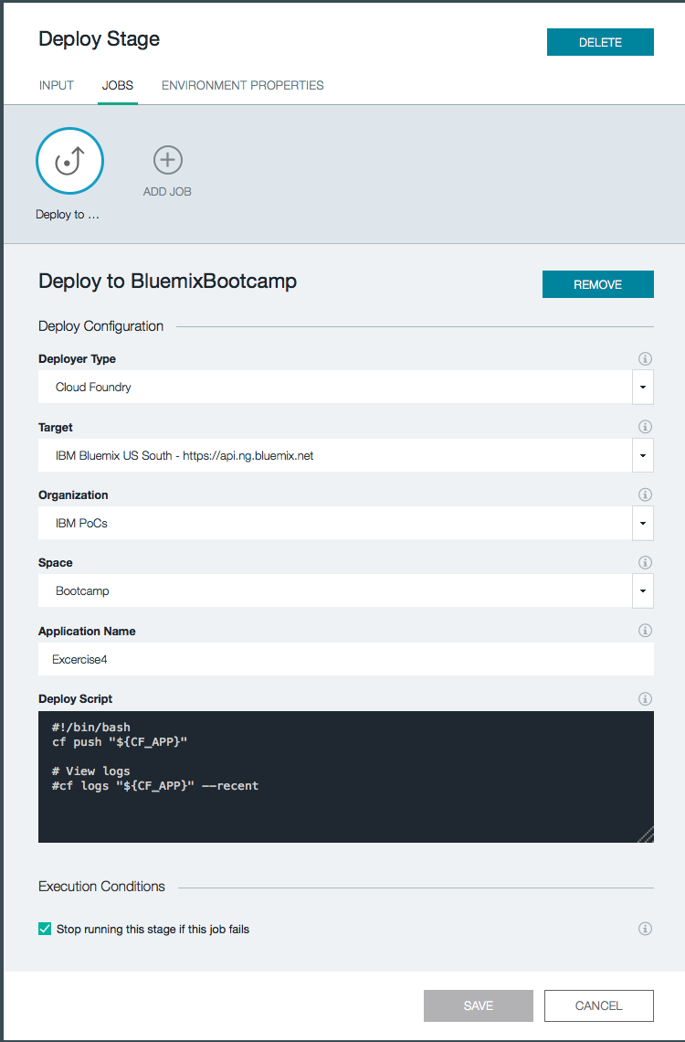
5.3 DevOps – Build/Deploy#1(Stage Configuration)

Slide 34
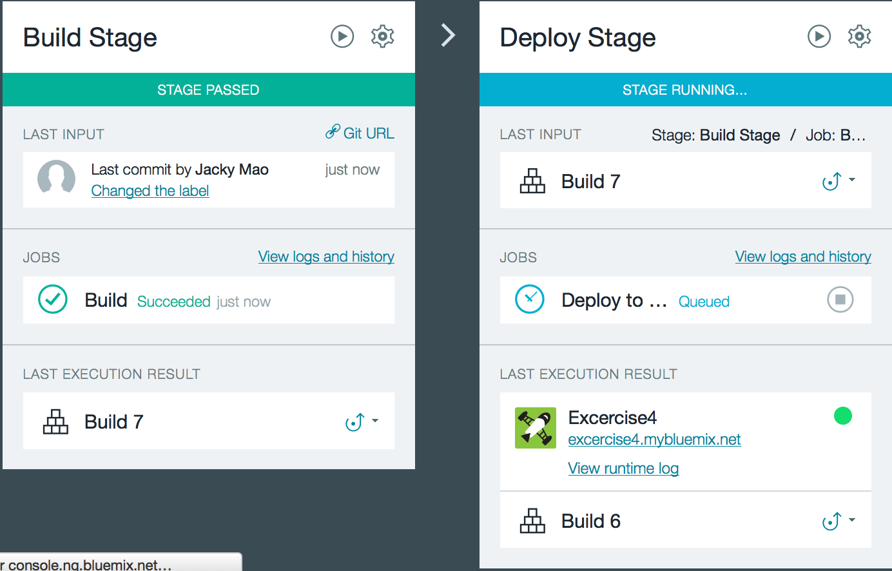
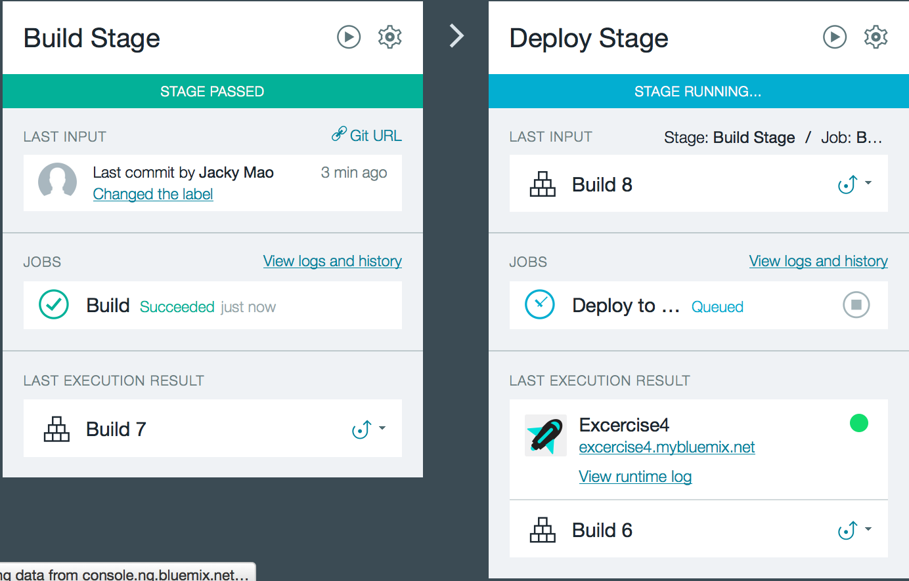
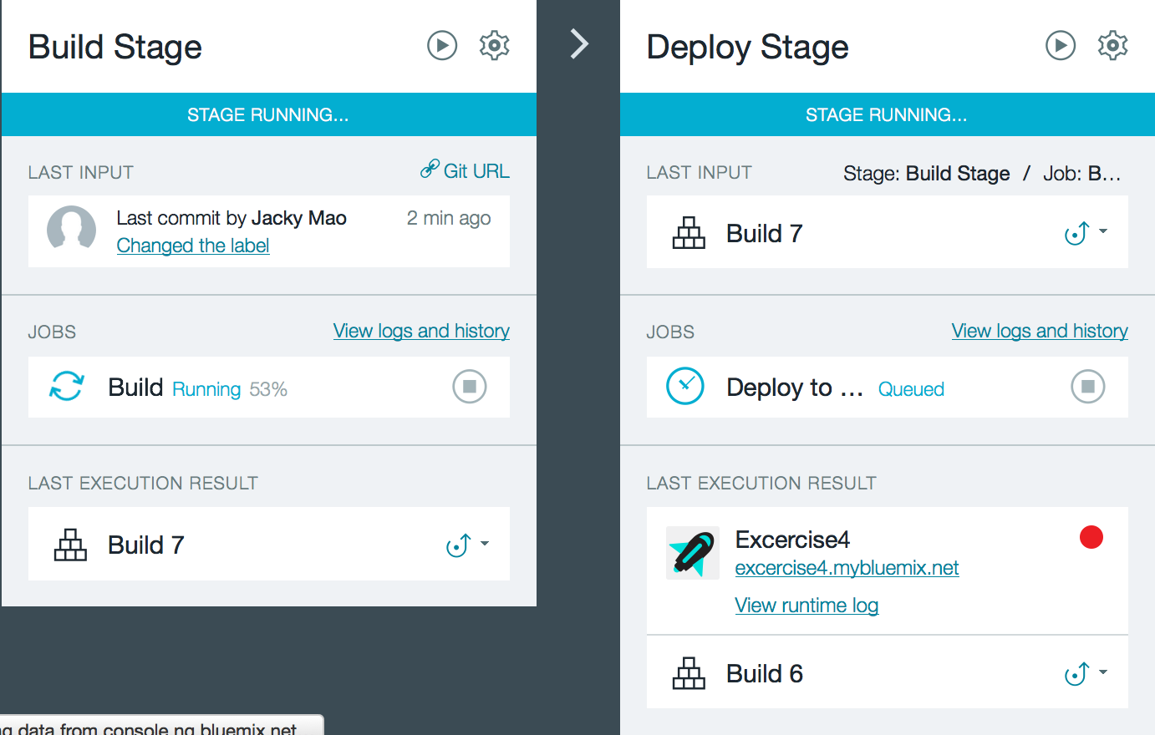
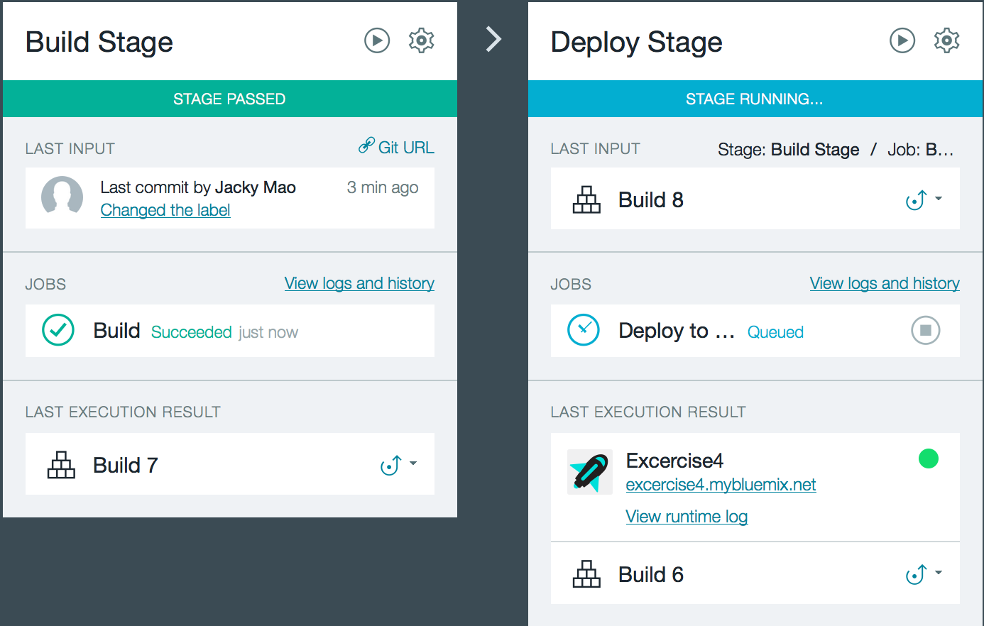
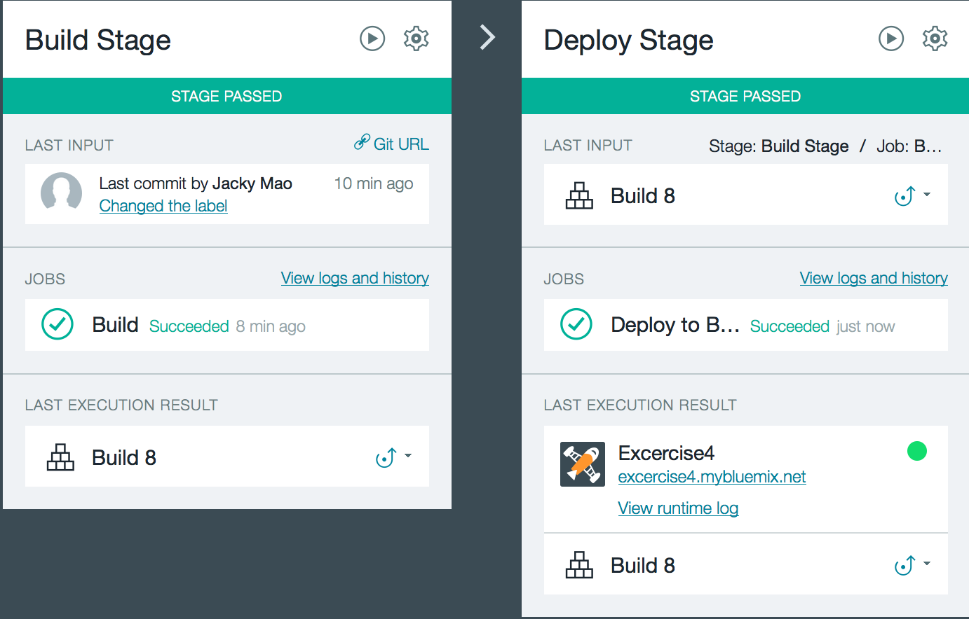
5.3 DevOps – Build/Deploy#2(Build-->Deploy)

Slide 35
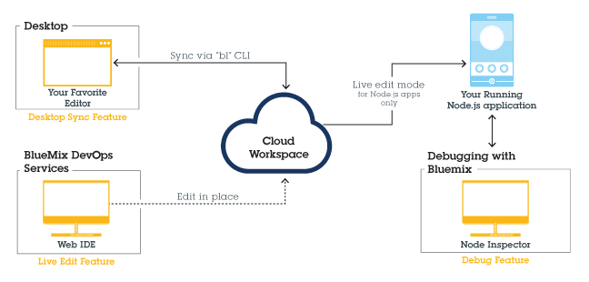
5.4 DevOps - Bluemix Live Sync Process
REF:https://www.ng.bluemix.net/docs/manageapps/bluemixlive.html

Slide 36
6 Practice tips
6.1. Migration tips:
Dynamic file system, so you can not write persistent content into file.
Replace the libraries with native dependencies with the other libraries.
Custom buildpack can fix some dependency libraries, but it is not strong.
The IPs for some services are for internal usage in Bluemix.
You can build the access bridge to Dedicated Bluemix with Cloud Integration Service in Public/SWG Bluemix.
Pls pay attention to the package conflict issue in Java.
6.2. Migration steps:
Estimate the gaps and features
Make code changes
Redeploy to Bluemix
Possible customized buildpacks

Slide 37
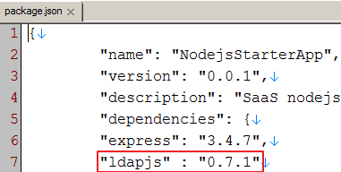
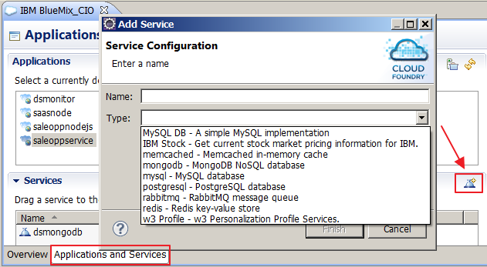
6 Practice tips - continued
6.3. Node.js modules management(cf command reference)
If the module version for different OS are not same, you can:
1.Add the module version information into package.json file as the left shown.
2. Remove the module files from node_modules .
3. Add –b parameter to specify the custom buildpack if need. e.g.:-b https://github.com/ibmdb/db2nodejsbuildpack
6.4. Add service by Bluemix Eclipse plugin(you can get it in eclipse marketplace)
If there is no UI to add service node such as CIO Bluemix, you can use Bluemix plugin to do it remotely.

Slide 38
7. Bluemix environments
CIO Bluemix: http://ace.ciopaas1.innovate.ibm.com (sunset)
Public/SWG Bluemix: http://console.ng.bluemix.net
Stage Bluemix: https://console.stage1.ng.bluemix.net
Dedicated Bluemix: https://console.w3ibm.bluemix.net
Difference among them:
Features | CIO | SWG | Stage | Dedicated
Stability | Good | Good | Bad | Good
Diversity | Bad | Good | Good | Good-
Zone | Blue | Red | Red | Yellow
Cost | Free | Charge/Free | Free | Free

Slide 39


Thanks!
The next billion dollar idea starts with a single developer.
That developer starts with a single line of code

Slide 40





Why Cloud Foundry?
Open Cloud Platform
There is an increasing appetite for cloud-based mobile, social and analytics applications from line-of-business executives - drives the need for a more open cloud development platform
Meets Developer’s Needs
Focus on app development, not provisioning VMs, databases, messaging servers, etc
Agile development model
Deploy and scale in seconds
Compelling Community
Cloud Foundry has a compelling community and emerging ecosystem as well as a mature set of capabilities and robustness

Slide 41










Cloud Foundry Components
Router
Cloud Foundry PaaS
Cloud Foundry services registry and runtime management layer. Components are dynamically discoverable and loosely coupled, exposing health through HTTP endpoints so agents can collect state and act on it.
User Authentication and Authorization
Cloud Controller
Health Manager
Service Gateway
DEA Pool
Apps
Service Nodes
Service Connector
Build Packs
Application Execution (DEA)
The Droplet Execution Agent manages application instances, tracks started instances, and broadcasts state messages.
Messaging
Cloud Foundry BOSH
Public Clouds
Private Clouds
Micro Clouds
Notes:
Cloud Foundry PaaS
An application runs in a DEA. The Cloud Controller orchestrates the routing and lifecycle of all DEAs in the pool. Routers manage application traffic. Health Manager reports mismatched application states to the CC. A service gateway provides an interface for services (native or external). A messaging bus manages all system communication. Apps are accessed directly through the router while web and CLI clients (e.g., vmc, STS) access Cloud Controller via RESTful services.

